Slide 1
Object-Oriented Systems
Analysis and Design Using UML
(Sequence Diagram)
Systems Analysis and Design
Course Code: CSE 305
Instructor:

Slide 2
Sequence Diagrams
Sequence diagram is one of the best ways to identify the requirements and processes of a system.
This is an interaction diagram that illustrates how objects in a system communicate with each other.
Each object passes on some messages to another in a sequential time or order of steps in a process.
18-<number>

Slide 3
Sequence Diagrams
A sequence diagram is composed of elements and icons which you need to be familiar with in order to create one.
There are basic symbols, components, and types of message arrows that may occur in a UML sequence diagram example.
18-<number>

Slide 4
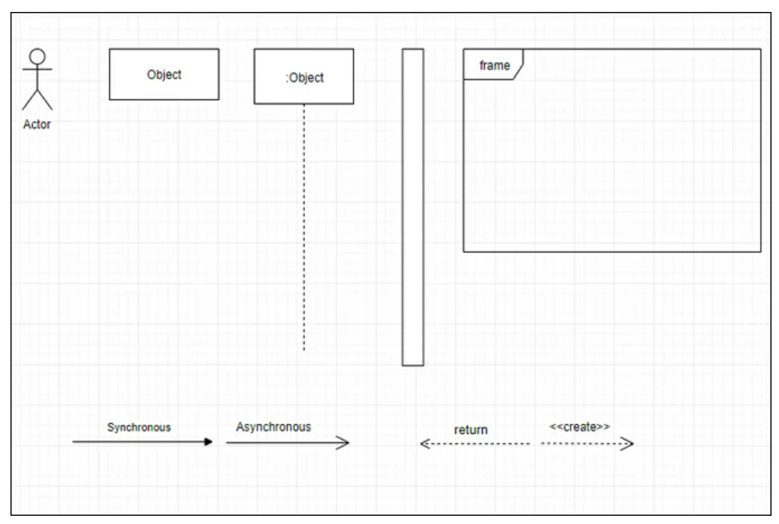
Sequence Diagrams Notation
..
Specific object name
Anonymous object
Dashed line is the lifeline/Timeline
of object
18-<number>

Slide 5
Sequence Diagrams Notation
Actor – An external entity that interact with the system.
Object – Refers to the rectangle symbol in a system that describes the responsibility for things like managing data, moving data around in the system, responding to inquiries, and protecting the system. Objects work together by communicating or interacting with one another.
Activation Bar – A rectangle shape placed on a lifeline that indicates the time or duration an object needs to finish a task.
Lifeline – Is a vertical dashed line that represents the presence of an object over time.
18-<number>

Slide 6
Sequence Diagrams Notation
Synchronous – Represents a message where the sender waits for the response of the receiver before the message continues. This illustrates a line with a solid arrowhead.
Asynchronous – A type of message that does not need a response from the receiver before the message gets back and carries another message. This is usually drawn with a solid line and an open arrowhead.
Return Message – It represents a symbol of a dashed line with an open arrowhead in response to the calls from the original lifeline.
Create Message – Used to create an object in a sequence diagram example that is usually drawn using a dashed line and an open arrowhead pointing to the object created
18-<number>

Slide 7
Sequence diagram example for Online Shopping
A sequence diagram is used in various fields that involve processes, for example online shopping system.
In this UML sequence diagram example, you will see the flow of ordering items online from browsing items to the confirmation of the order via email as shown in the illustration.
18-<number>

Slide 8
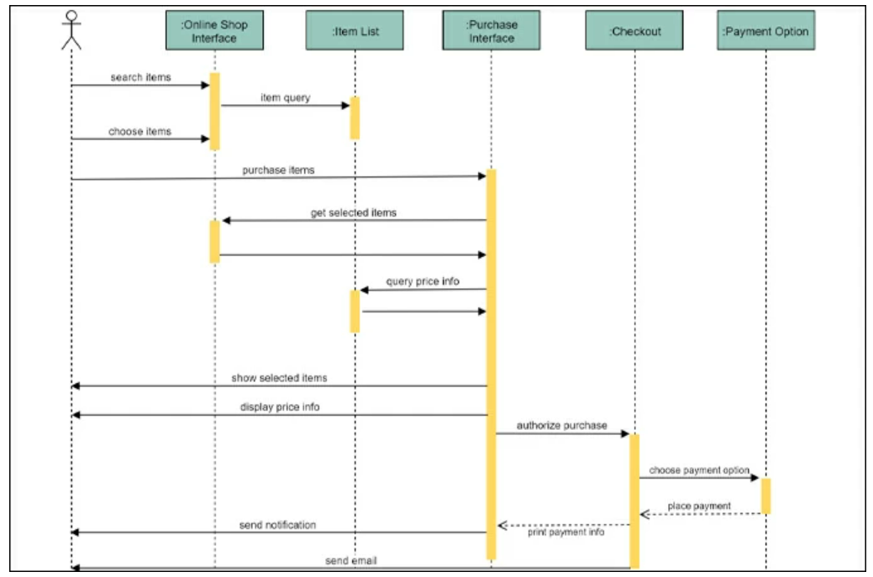
Sequence diagram example for Online Shopping
..
18-<number>

Slide 9
Sequence diagram example for Library Management System
There is a volume of students renting books from the library. To regulate this, it’s essential for students to have online access to the record of available books. This system sequence diagram example is just made for this purpose. Also, the system will also inform the student if they exceeded the allotted time for renting a book and a penalty will apply accordingly.
18-<number>

Slide 10
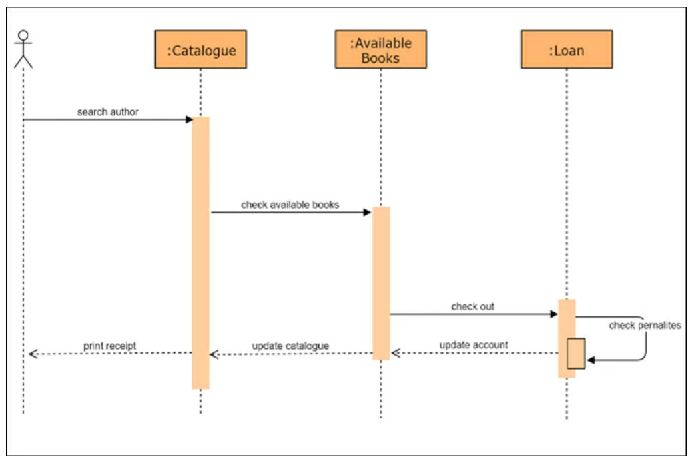
Sequence diagram example for Library Management System
..
18-<number>

Slide 11
Sequence diagram example for ATM
An automated teller machine lets you access your bank account. With it, you can check your balance, enter the amount to withdraw, and many more. The sequence diagram example of an ATM below shows the processes in sequential order. From the interface access, ATM control, transaction unit, and printer.
18-<number>

Slide 12
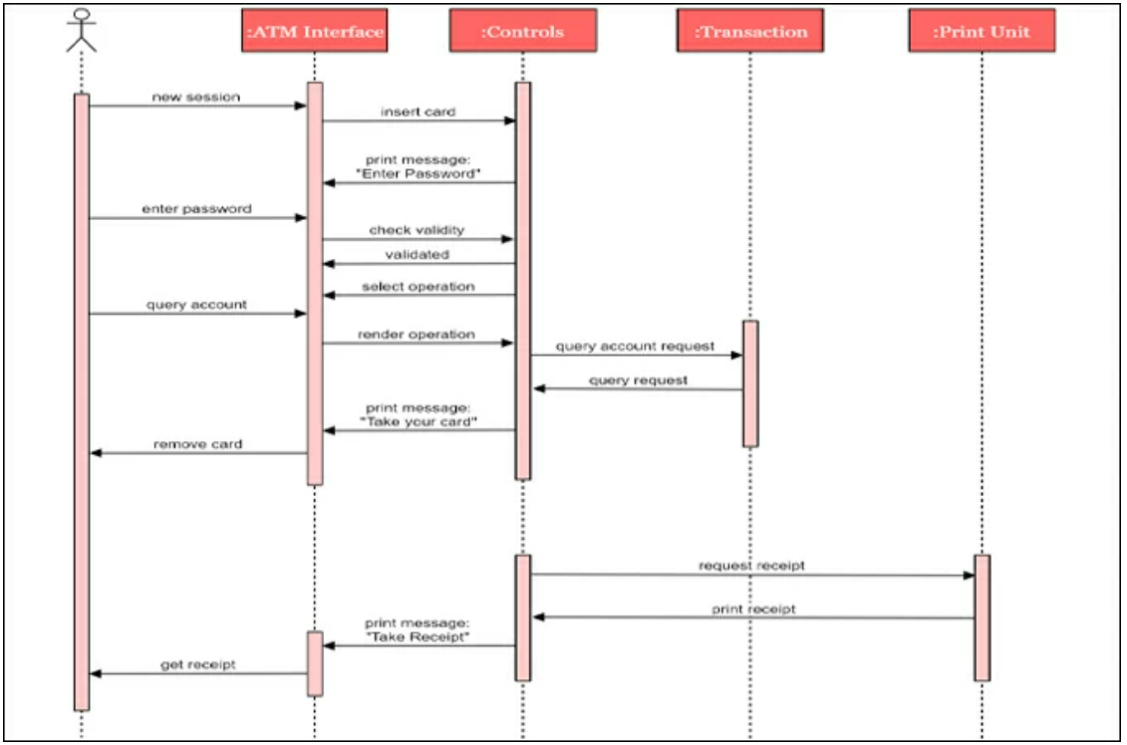
Sequence diagram example for ATM
..
18-<number>

Slide 13
Sequence diagram example for Hospital Management System
Through the help of a hospital management system, the establishment will be able to manage the volume of information. Moreover, doctors or nurses will be able to track the status, and health history of patients. That is illustrated in the system sequence diagram example below.
18-<number>

Slide 14
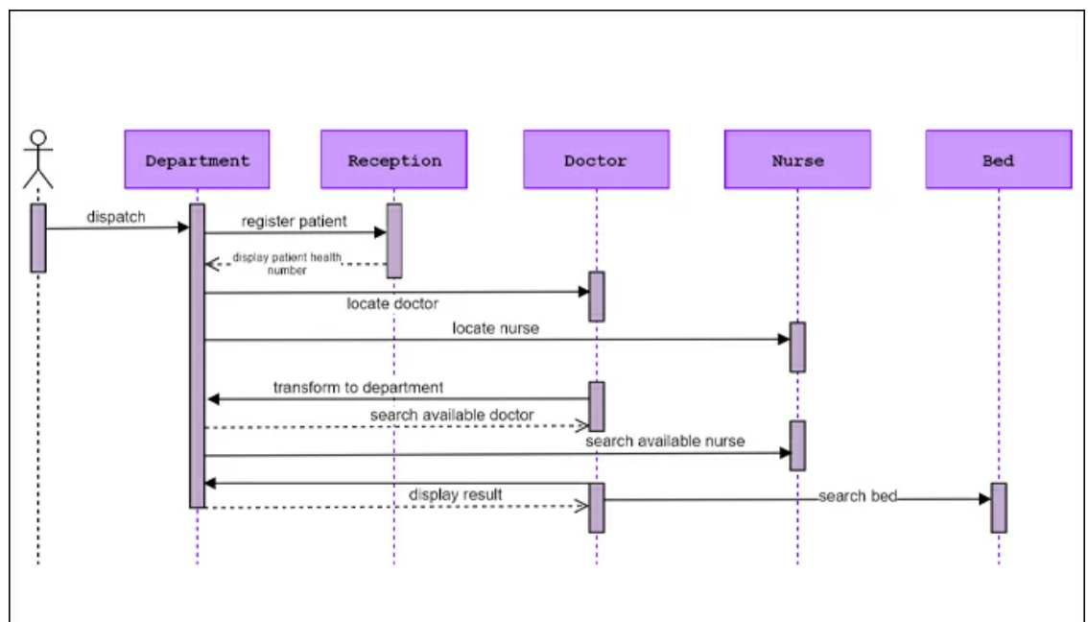
Sequence diagram example for Hospital Management System
..
18-<number>

Slide 15
The following sequence diagram example represents McDonald’s ordering system:
The ordered sequence of events in a given sequence diagram is as follows:
Place an order.
Pay money to the cash counter.
Order Confirmation.
Order preparation.
Order serving.
18-<number>

Slide 16
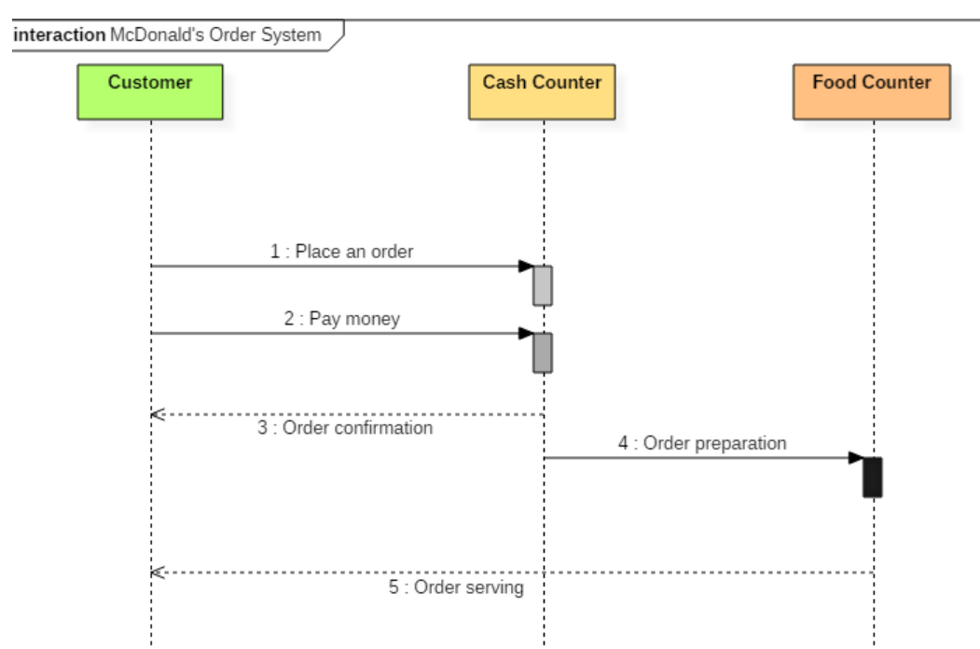
The following sequence diagram example represents McDonald’s ordering system:
18-<number>

Slide 17
Benefits of a Sequence Diagram
Sequence diagrams are used to explore any real application or a system.
Sequence diagrams are used to represent message flow from one object to another object.
Sequence diagrams are easier to maintain.
Sequence diagrams are easier to generate.
Sequence diagrams can be easily updated according to the changes within a system.
Sequence diagram allows reverse as well as forward engineering.
18-<number>

Slide 18
Drawbacks of a sequence diagram
Sequence diagrams can become complex when too many lifelines are involved in the system.
If the order of message sequence is changed, then incorrect results are produced.
Each sequence needs to be represented using different message notation, which can be a little complex.
The type of message decides the type of sequence inside the diagram.
18-<number>

Slide 19
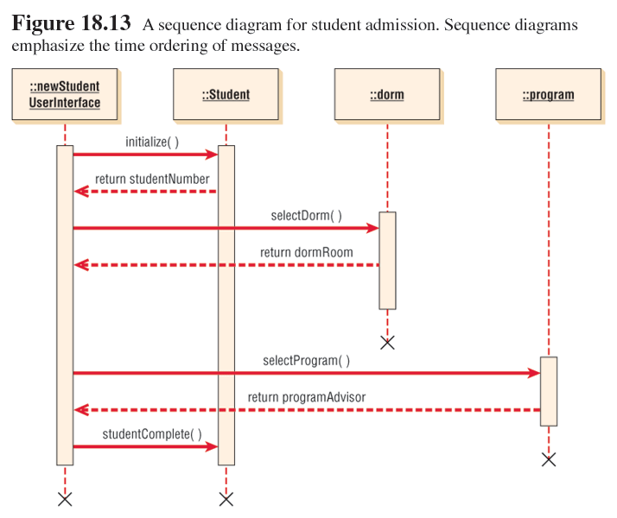
Sequence Diagram Example
18-<number>

Slide 20
Steps Used in UML
The steps used in UML are:
  Define the use case model.
  Continue UML diagramming to model the system. during the systems analysis phase.
  Develop the class diagrams.
  Draw statechart diagrams.
  Begin systems design by refining the UML diagrams.
  Document your system design in detail.
18-<number>

